Slide 1
Petabytes of Data - How to Use R at Scale
Jeff Fletcher
jfletcher@cloudera.com
https://www.linkedin.com/in/jefffletcher/

Slide 2
AGENDA
WHAT PROBLEM ARE WE SOLVING?
HOW IS IT SOLVED OUTSIDE OF R?
QUICK COMPONENTS OVERVIEW
HOW DOES THIS WORK WITH R?
USEFUL THINGS TO KNOW
GETTING STARTED

Slide 3
WHAT PROBLEM ARE WE SOLVING?

Slide 4
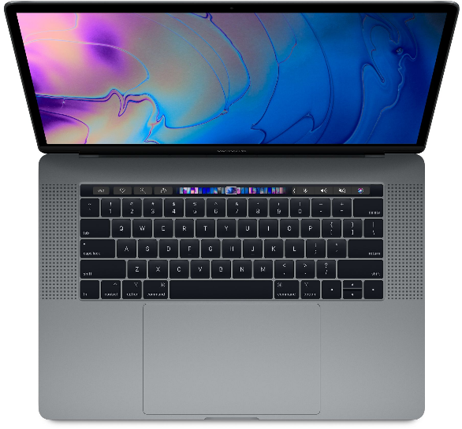
WHAT PROBLEM ARE WE SOLVING?
Your MacBook, while very cool and shiny is too small for the enormous amounts of data used by actual enterprise companies.

Slide 5
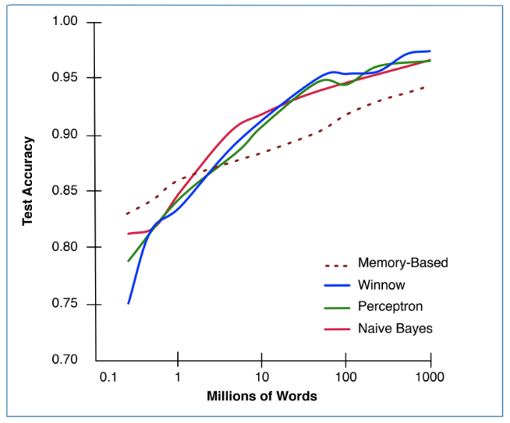
WHAT PROBLEM ARE WE SOLVING?
“It’s not who has the best algorithms that wins. It’s who has the most data.” [Banko and Brill, 2001]
Notes:
Single node problem
*HDD size
Using the big data stack
DS over bigger data and a longer time
Security concerns / portable data
*ML at Scale / Branko

Slide 6
HOW IS THIS SOLVED OUTSIDE OF R?

Slide 7

HOW IS THIS SOLVED OUTSIDE OF R?
One of the many Jeff Dean facts: Jeff Dean's PIN is the last 4 digits of pi.
The rest are funny-ish, but a good way to kill 20 mins on a many person webex.

Slide 8
HADOOP STACK
Hive
MapReduce
Our template says I should put some related text here. How about - this layout was approved by Piet Mondrian.
YARN
HDFS

Slide 9

HOW IS THIS SOLVED OUTSIDE OF R?
A Dutch painter and theoretician who is regarded as one of the greatest artists of the 20th century. Painty Piet I like to call him.

Slide 10
HADOOP STACK WITH SPARK
Hive
SPARK
MapReduce
He proclaimed in 1914: Art is higher than reality and has no direct relation to reality…
According to Wikipedia anyway. I didn’t hear him say it.
YARN
HDFS

Slide 11
SPARK OVERVIEW

Slide 12

SPARK
Data Nodes
Resource Manager
Client Program
EXECUTOR
TASK
TASK
Spark Driver
EXECUTOR
TASK
TASK

Slide 13
SPARK RDD
Node
Node
Node
Node
YARN
SPARK
HDFS

Slide 14
SPARK DATAFRAME
Notes:
RDD of Type Row
Headers and Schema
Parquet

Slide 15
SPARK DATAFRAME OPERATIONS
Map
Filter
GroupBy
Join
Take
Map

Slide 16
SPARK LIBRARIES
SQL
Streaming
MLlib
GraphX
SPARK
Apart from libraries, there are many books on Spark. Look for stuff by Holden Karau.
YARN
HDFS
Notes:
All upgraded at the same time

Slide 17
HOW DOES THIS WORK WITH R?

Slide 18
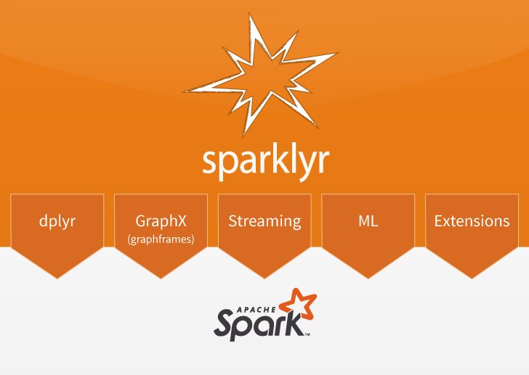
SPARKLYR
The silver medal goes to SparkR. Sparklyr 1.0.0 has most of the things you need and support for Arrow.
Notes:
And SparkR

Slide 19

SPARKLYR
Data Nodes
EXECUTOR
Client Program
TASK
TASK
RM
R
R
R
Sparklyr
Spark Driver
EXECUTOR
TASK
TASK
R
R
Notes:
spark_apply()

Slide 20

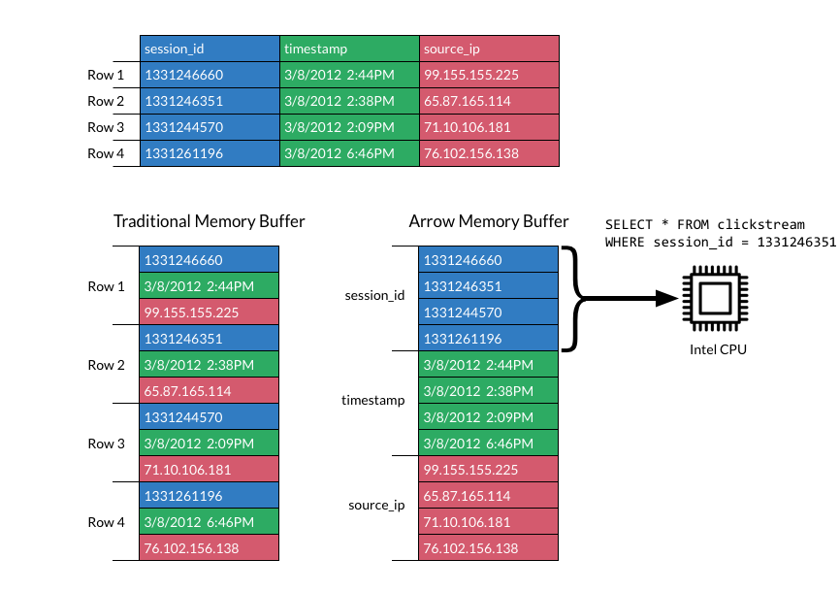
APACHE ARROW
High speed in memory data processing for everybody!

Slide 21
USEFUL THINGS TO KNOW

Slide 22
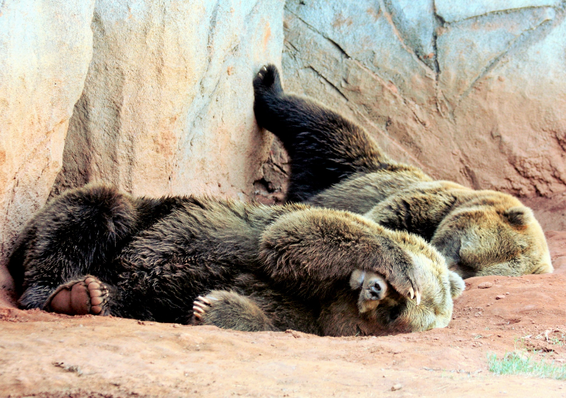
LAZY EVALUATION
This catches people out when working on the command line. Entered does not mean executed.

Slide 23
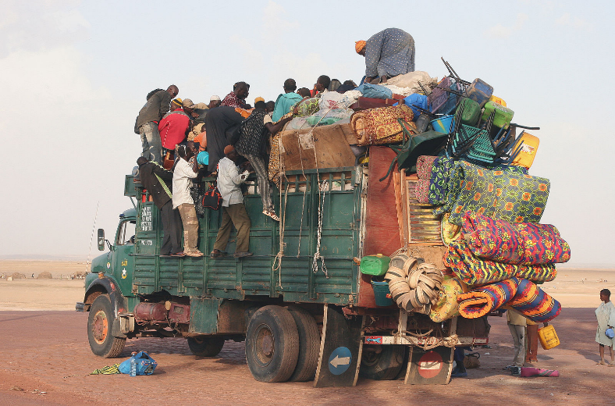
OVERLOADING THE DRIVER
I see this often when talking with data science teams. It’s part of the standard operating procedure for “small data” data science work.

Slide 24

AVOID GROUPBYKEY
Use ReduceByKey. All the cool kids are doing it.

Slide 25
CHECK FOR DATA SKEW
I did not spend a lot of time drawing this. But Edward Tufte would be proud. Very favourable data to ink ratio.

Slide 26
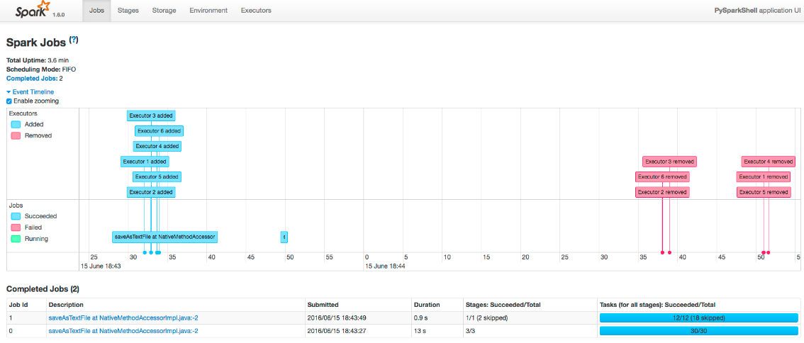
USE THE SPARK UI

Slide 27
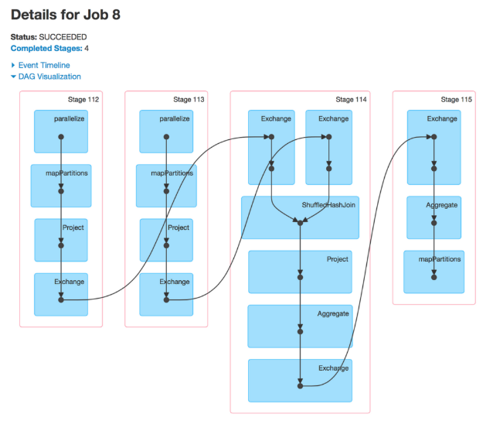
DAG
Directed Acyclic Graph - Use the full title if you want to sound smarter while talking data scientists.

Slide 28

CHECK OUT IMPLYR
delay <- flights_tbl %>%
select(tailnum, distance, arr_delay) %>%
group_by(tailnum) %>%
summarise(count = n(), dist = mean(distance), delay = mean(arr_delay)) %>%
filter(count > 20L, dist < 2000L, !is.na(delay)) %>%
arrange(delay, dist, count) %>%
collect()

Slide 29
GETTING STARTED

Slide 30
GETTING STARTED
Implyr
https://blog.cloudera.com/blog/2017/07/implyr-r-interface-for-apache-impala/
https://github.com/ianmcook/implyr
Sparklyr
https://blog.cloudera.com/blog/2016/09/introducing-sparklyr-an-r-interface-for-apache-spark/ https://spark.rstudio.com/
Spark
https://www.cloudera.com/documentation/enterprise/5-16-x/PDF/cloudera-spark.pdf https://www.cloudera.com/products/open-source/apache-hadoop/apache-spark.html

Slide 32
IMAGES USED
Most diagrams I either drew or took from Cloudera’s documentation directly. The rest come from here:
https://www.apple.com/shop/buy-mac/macbook-pro/15-inch-space-gray-2.6ghz-6-core-512gb
http://web.cs.ucla.edu/classes/winter13/cs111/scribe/10c/
https://commons.wikimedia.org/wiki/File:Special_Edition_NYC_2015_-_DC_vs_Street_Fighter_(18357923460).jpg
https://commons.wikimedia.org/wiki/File:Overloaded_truck.jpg
https://www.publicdomainpictures.net/en/view-image.php?image=220900&picture=two-lazy-bears
https://www.goodfreephotos.com/other-photos/lots-of-keys.jpg.php

